Slide 1
Textual Emotion-Cause Pair Extraction
A New Task to Emotion Analysis in Texts
Natural Language Processing
Presented by Suparshwa Patil Shreyas Bedekar Shruti Mandaokar

Slide 2
Emotion Cause Pair Extraction
SemEval 2024 (Task 3)
Identifying pairs from a conversation where one utterance expresses an emotion and another provides the cause of that emotion.
Cause Emotion
After hearing that I got the job, I was jumping with joy all day long.

Slide 3
How does it happen in Conversations?
My project was a huge success at the presentation today.
That's great to hear! You worked really hard on it. I know, I feel so proud and relieved it's over.
Emotion-Cause Pair:
(Happiness, “My project was a huge success at the presentation today.”)

Slide 4
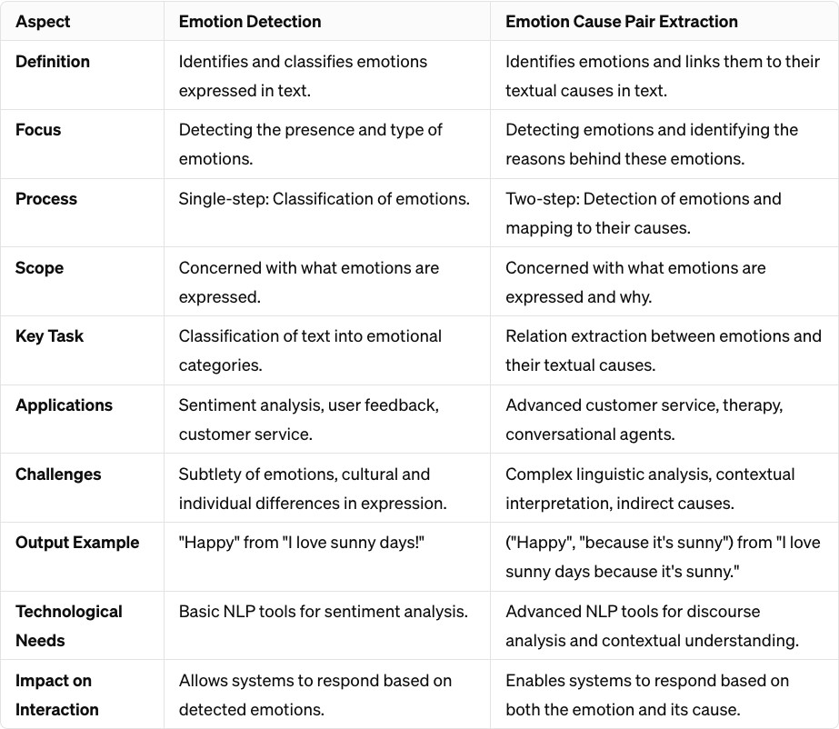
ECE vs ECPE

Slide 5
The Problem
A single word or phrase might convey different emotions based on the surrounding text or the overall situation described,
Contextual Understanding
Multiple Possible Causes
Temporal Dependencies
Cross-Utterance Emotional Causes
, Emotion Cause Extraction (ECE) faces limitations due to its conventional emotion classification approach, hindering its applicability in real-world scenarios
Emotion Cause Pair Extraction aims to bridge this gap by identifying the causal factors that lead to specific emotional states over conversations.

Slide 6
Our Motivation
Advancing Emotionally Intelligent Systems
Contextual Understanding in Conversations
Granular Emotional Analysis in Texts
Integration with Other Modalities in Future

Slide 7
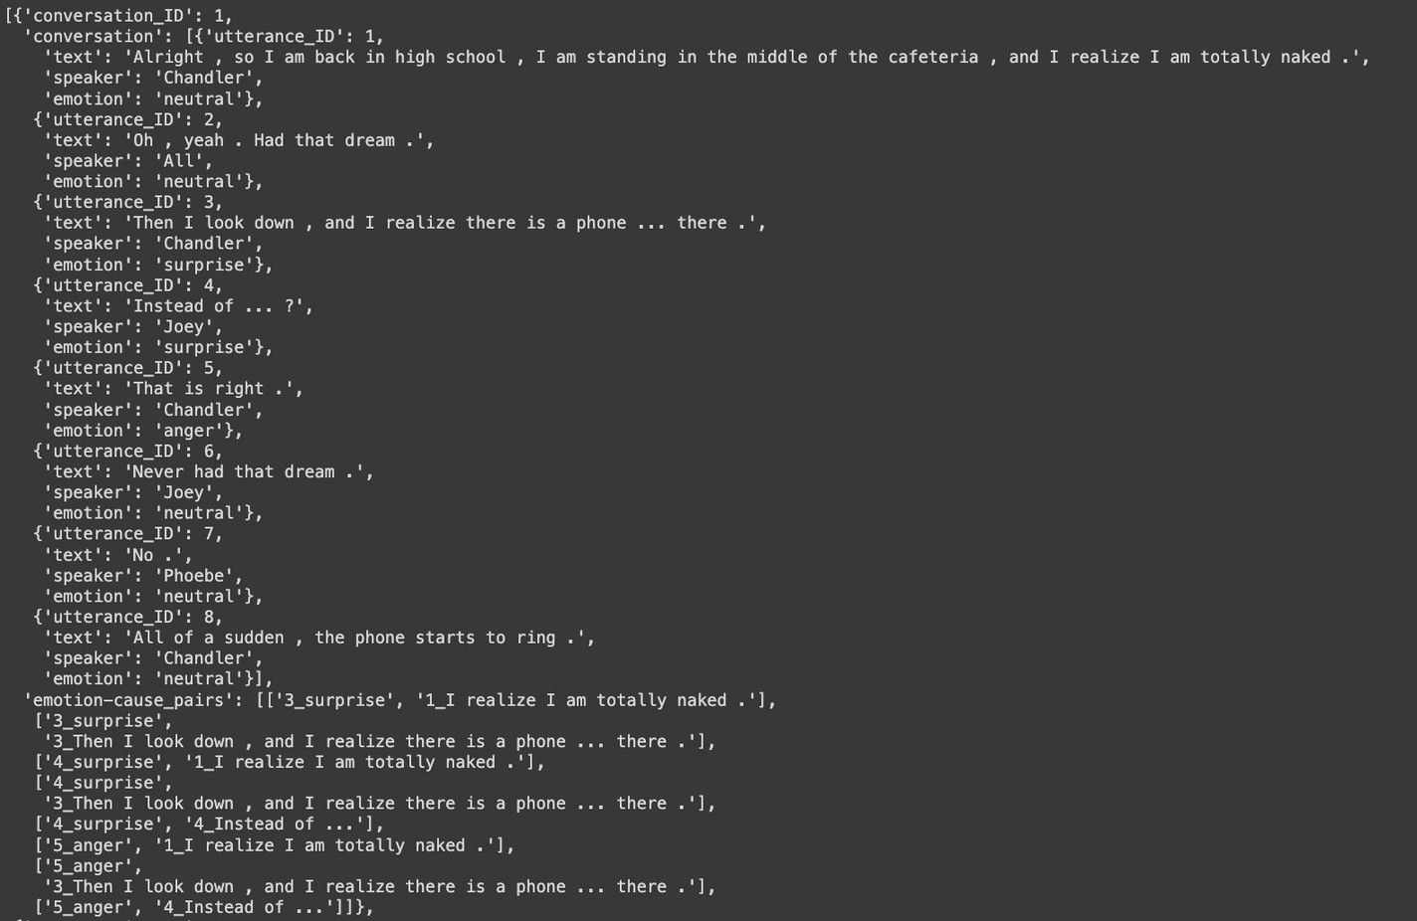
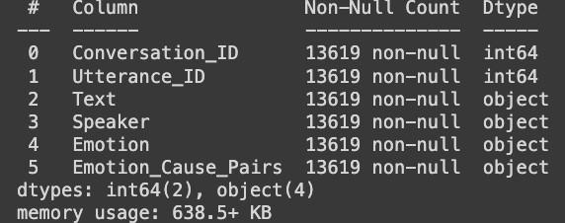
Problem Statement
Given a conversation containing textual data, the goal is to output all emotion-cause pairs,
each containing an emotion along with textual cause pan in a specific cause utterance.

Slide 8
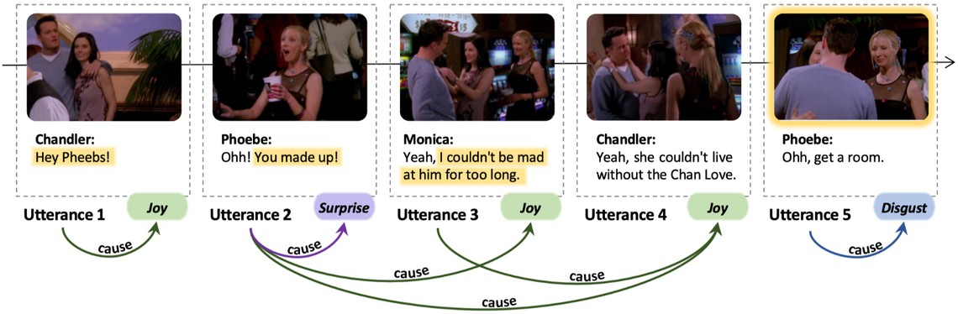
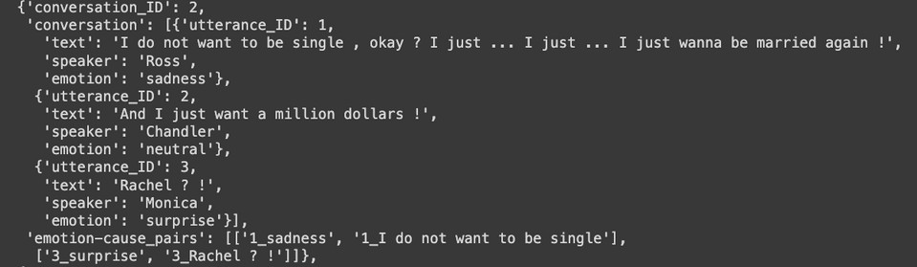
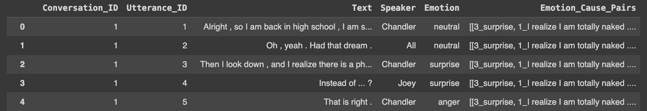
Dataset
Emotion-Cause-in-Friends
Training Data:
Conversations: 1,374 total
Utterances: 13,619 total
conversation_ID: Unique identifier for the conversation.
conversation: List of utterances exchanged in the conversation.
utterance_ID: Unique identifier for each utterance.
text: Text content of the utterance.
speaker: Speaker who uttered the text.
emotion: Emotion associated with the utterance.
emotion-cause_pairs: List of emotion-cause pairs extracted from the conversation.
Each pair consists of:
Emotion label: The type of emotion expressed in the utterance.
Cause: The textual content or event that triggered the emotion, represented as a string.
Evaluation Data:
Comprising 341 conversations
1and 3,101 utterances

Slide 9
Experiments
on Emotion Cause Pair Extraction
01
Emotion Classification
02
Cause Extraction
Logistic Regression + TFIDF BERT
RoBERTa
DistilBERT RoBERTa

Slide 10
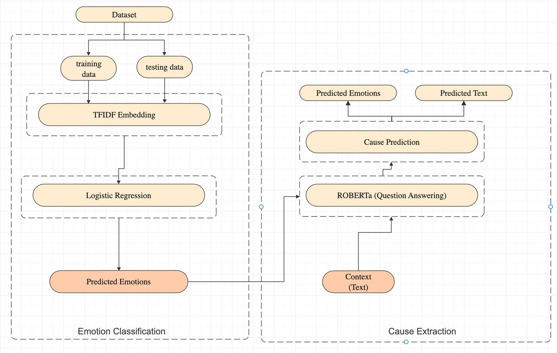
Flowchart

Slide 11
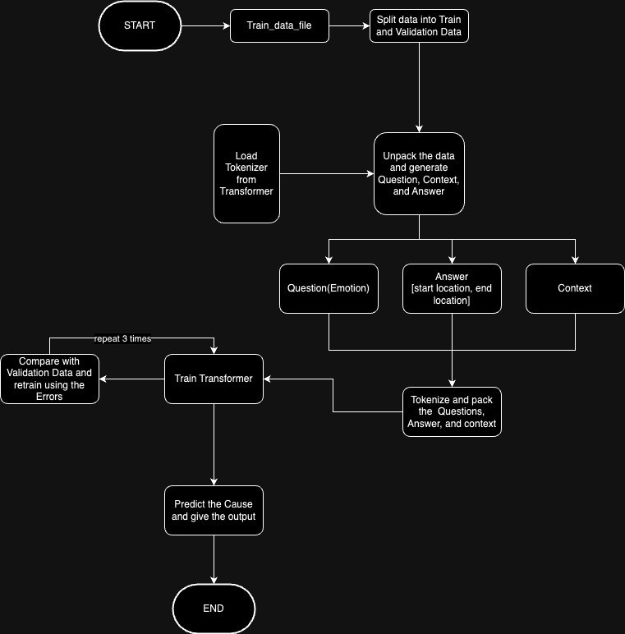
Flowchart

Slide 12
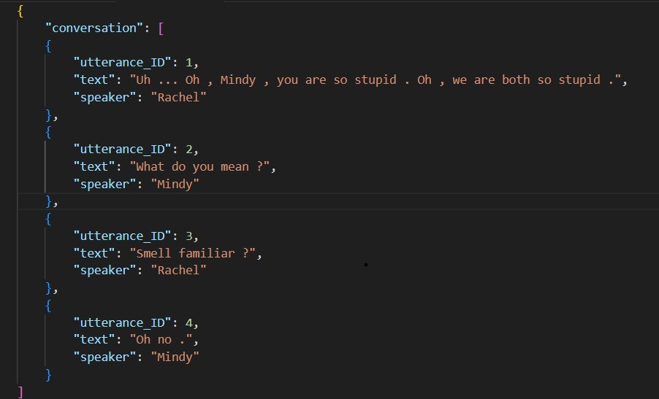
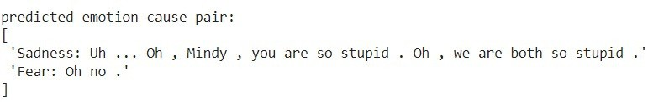
Result
Emotion Extraction and Cause Extraction are not mutually independent
Providing emotions can help better discover the causes; also, knowing causes may also help more accurately extract emotions

Slide 13

Result
Emotion Extraction and Cause Extraction are not mutually independent
Providing emotions can help better discover the causes; also, knowing causes may also help more accurately extract emotions
Logistic Regression
72% Accuracy Learning Rate -1e-5
RoBERTa
60% Accuracy Learning Rate -1e-5
BERT
50% Accuracy Learning Rate -1e-5

Slide 14
Analysis
Transformers capture complex relationships in text vs Logistic Regression focus on interpretable features
This analysis is based on limited data. Performance could vary with a larger and more diverse dataset.
If we want to capture subtle emotional cues, BERT or RoBERTa might be more suitable despite their lower accuracy in this test.

Slide 15
Thank You

